Slide 1
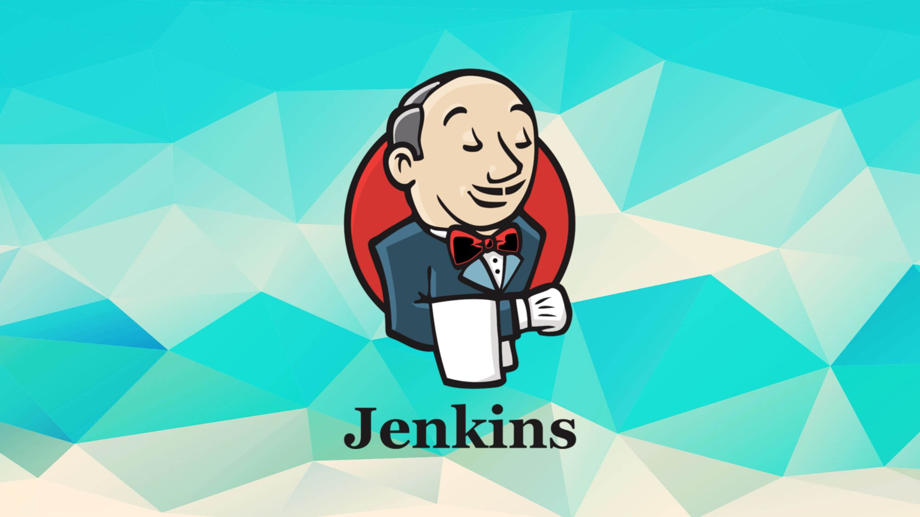
JENKINS PORT NUMBER CHANGED 8080 T0 8090

Slide 2
WHAT IS JENKINS
Jenkins is an open source automation tool written in java-programming language that allows continous integration.
Jenkins will build and test the code. It supports continuous integration (CI) and continuous delivery (CD) pipelines, allowing teams to quickly integrate changes into a project and automate the deployment process.
This Photo by Unknown Author is licensed under CC BY-SA

Slide 3
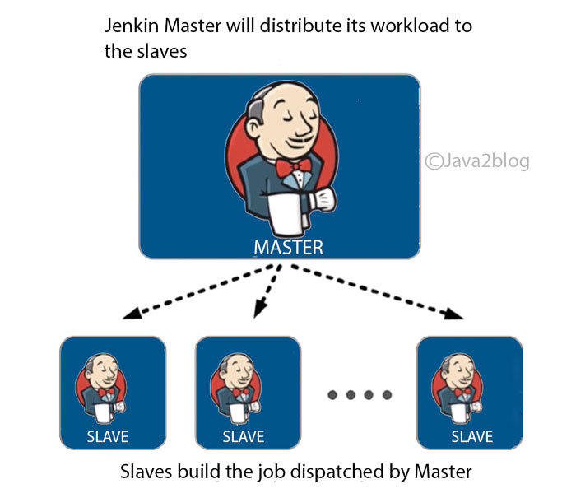
ARCHITECTURE OF JENKINS

Slide 4
Advantages of jenkins
OPEN SOURCE
EXTENSIVE PLUGIN ECOSYSTEM
EASY INSTALLATION AND CONFIGURATION
SUPPORT FOR MULTIPLE LANGUAGES
CONTINUOUS INTEGRATION AND CONTINUOUS DELIVERY
DISTRIBUTED BUILDS
SCALABILITY
CUSTOMIZATION
INTEGRATION WITH DEVEOPS TOOLS
ROBUST COMMUNITY AND SUPPORT

Slide 5
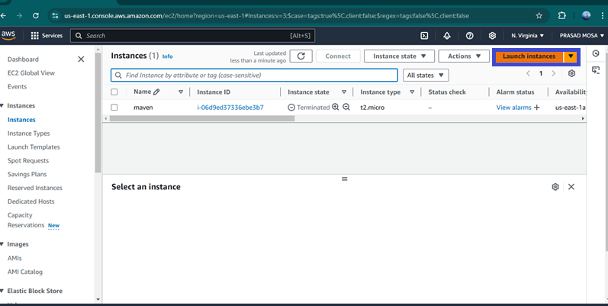
STEP 1: First we Need to Create one Ec2 instance in Aws console First click on launch ec2 instance in Dashboard

Slide 6
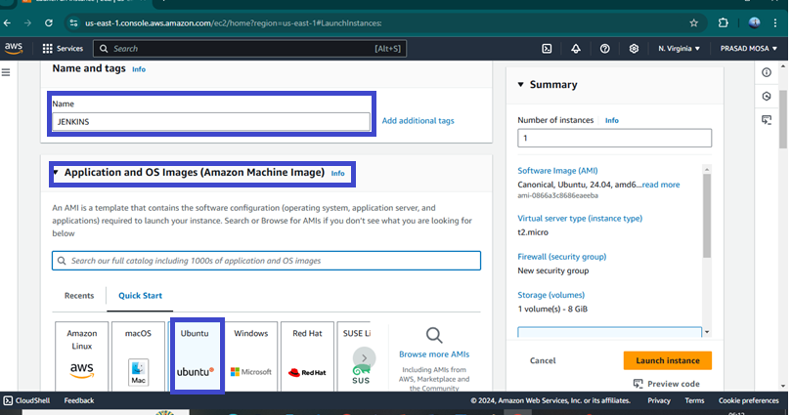
after click on launch instance need to provide name and select ami(like linux,ubuntu)

Slide 7
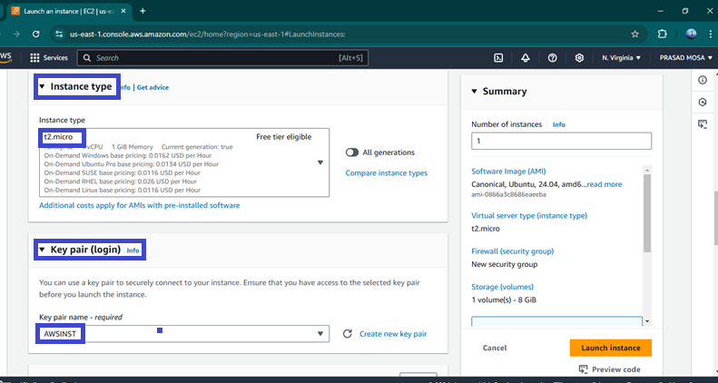
Then select Instance Type as t2.large and select any existing key pair or create new key by click create new key pair.

Slide 8
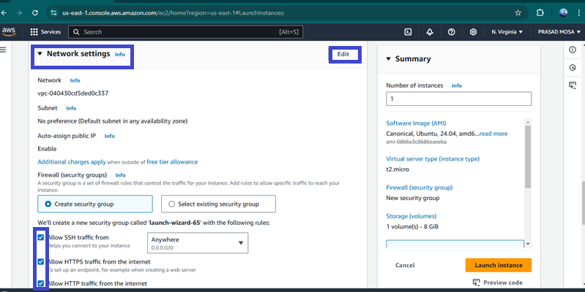
Then go the Network settings and then Allow the HTTP & HTTPS then click on Edit then add security group with All TCP then click on Launch Instance.

Slide 9
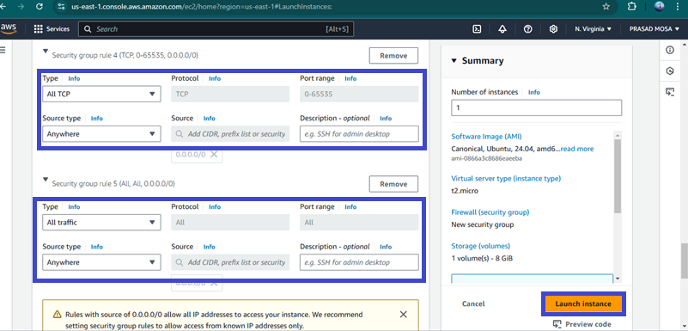

Slide 10
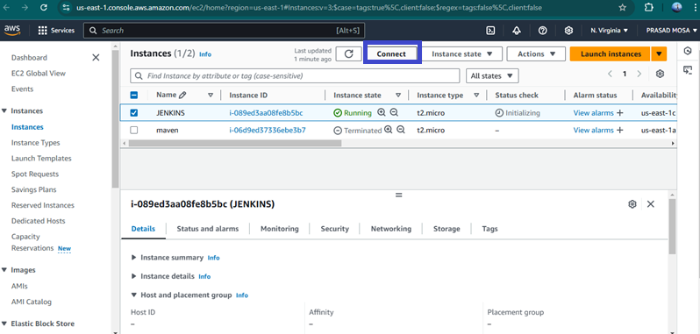
After the Instance Created then Connect the instance with any tool(Git , Mobexterm etc..,) with SSH Key

Slide 11
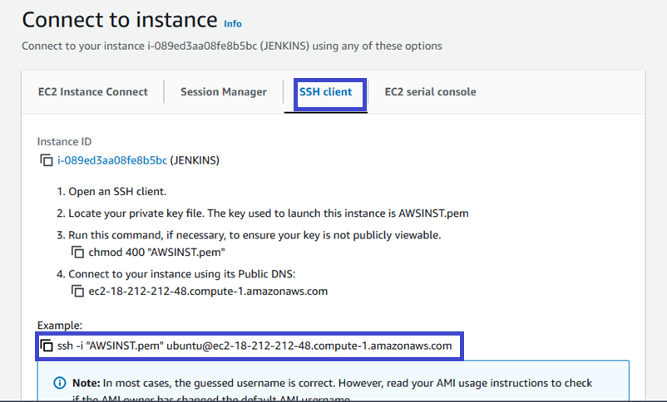

Slide 12
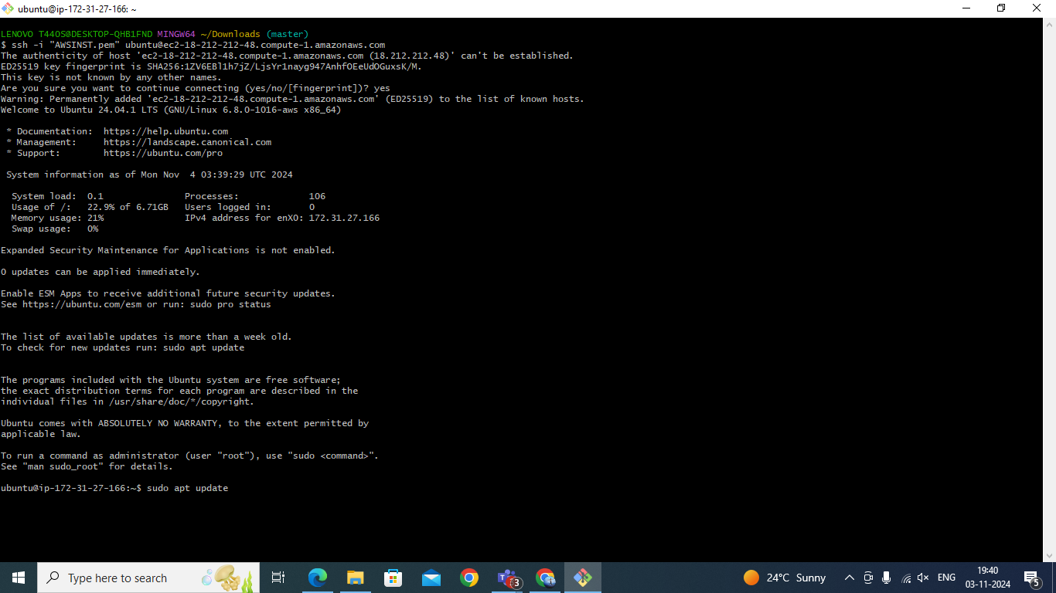
After Copy the SSH link paste that in any tool ( Git, Mobexterm etc.,) to connect with AWS.

Slide 13
To Install Jenkins follow below commands
sudo apt update -y
sudo apt upgrade -y
wget -O - https://packages.adoptium.net/artifactory/api/gpg/key/public | tee /etc/apt/keyrings/adoptium.asc
echo "deb [signed-by=/etc/apt/keyrings/adoptium.asc] https://packages.adoptium.net/artifactory/deb $(awk -F= '/^VERSION_CODENAME/{print$2}' /etc/os-release) main" | tee /etc/apt/sources.list.d/adoptium.list
Sudo apt update -y
Now need to Install Jdk in Instance for that use sudo apt install temurin-17-jdk -y

Slide 14
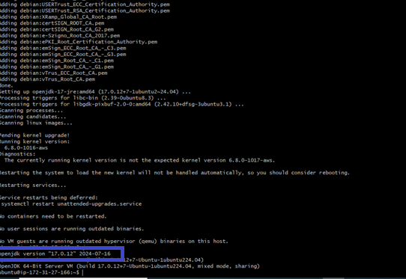
After Installing jdk check jdk version by using java --version

Slide 15
Then need to Install Jenkins before install need to add Keys for Jenkins
curl -fsSL https://pkg.jenkins.io/debian-stable/jenkins.io-2023.key | sudo tee \ /usr/share/keyrings/jenkins-keyring.asc > /dev/null
echo deb [signed-by=/usr/share/keyrings/jenkins-keyring.asc] \ https://pkg.jenkins.io/debian-stable binary/ | sudo tee /etc/apt/sources.list.d/jenkins.list > /dev/null
After Adding the keys need to install the Jenkins by using sudo apt-get install jenkins -y

Slide 16
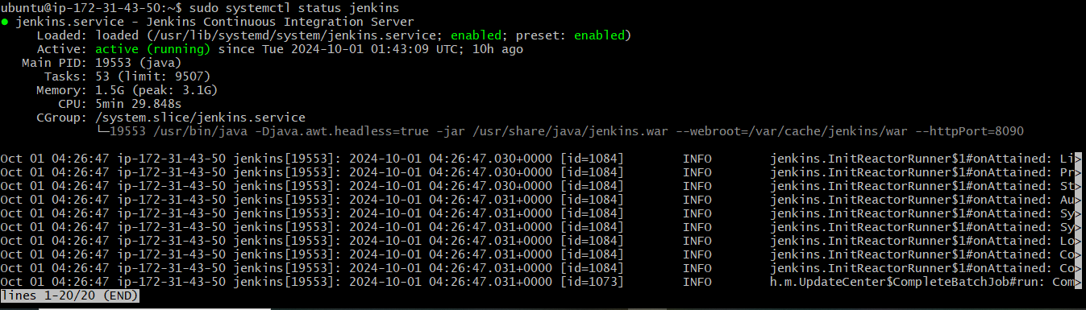
After Jenkins Installed need to check Jenkins version
Then start the jenkins by using sudo systemctl start jenkins
After starting the Jenkins need to check status of Jnekins it is active or not by using sudo systemctl status jenkins

Slide 17
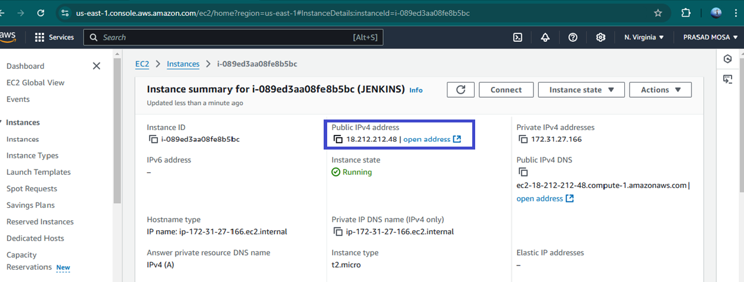
Then connect to the Jenkins dashboard by using instance public IPV4 address:8080

Slide 18
Once Jenkins is installed and connected to dashboard then for this Application case, we are running Jenkins on another port. so change the port to 8090
For changing to 8090 port first need to stop Jenkins by using Sudo systemctl stop jenkins
Then check the status of jenkins it is inactive or not by using sudo systemctl status jenkins
Now we need to change the port to 8090 for that need to change the directory by using cd /etc/default

Slide 19
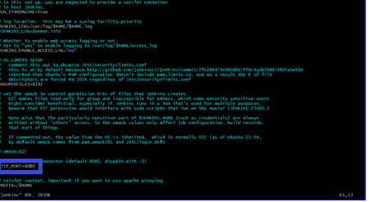
After changing into directory need to go vi editor to change the port number by using sudo vi jenkins
To exit form vi editor need to enter :wq

Slide 20
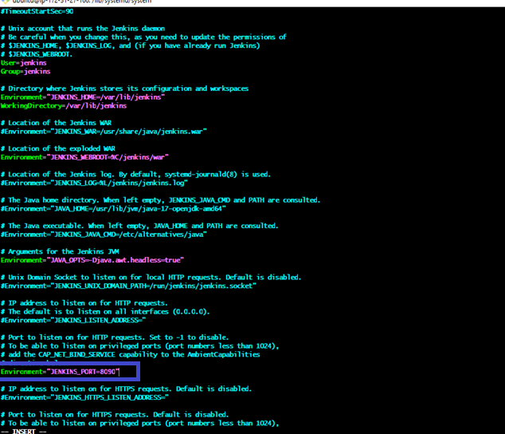
After exit from vi editor need to change to another directory by using cd /lib/systemd/system
After changing into above directory need to got vi editor again by using sudo vi jenkins.service in this need to change the jenkins port to 8090 and then exit form vi editor
After exit from vi editor need to reload the jenkins server by using sudo systemctl daemon-reload

Slide 21
Step-3: Jenkins dashboard creation
Then restart the jenkins server by using sudo systemctl restart Jenkins
After restarting the service then connect the with 8090 port
Now Unlock Jenkins using an administrative password
To get need to copy var path and paste in Git by using sudo cat var path to get administrative password

Slide 22
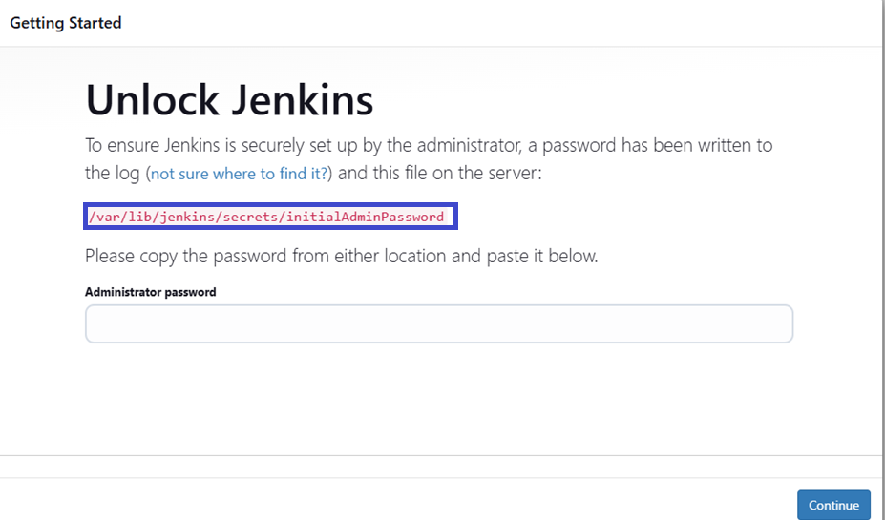

Slide 23
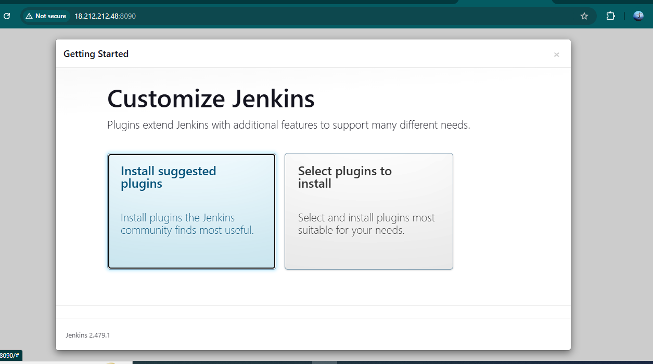
After unlocking the jenkins click on install the suggested plugins

Slide 24
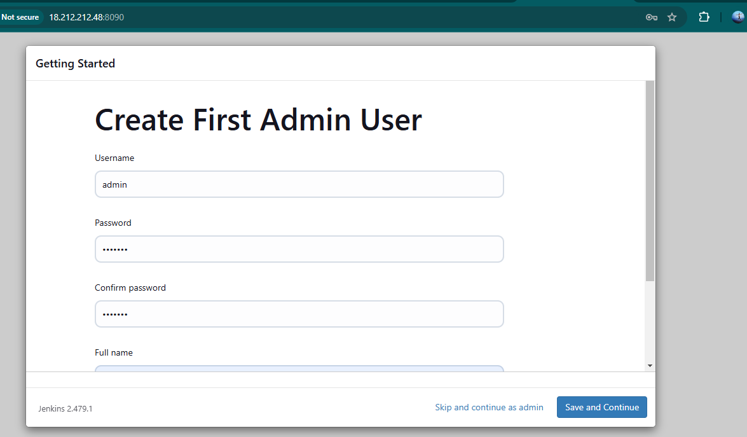
After successfully installation suggested we will get login page in that need to the enter below details
User name
Password
Conform Password
Full name
Email
After the all details need to
Click on save and continue

Slide 25
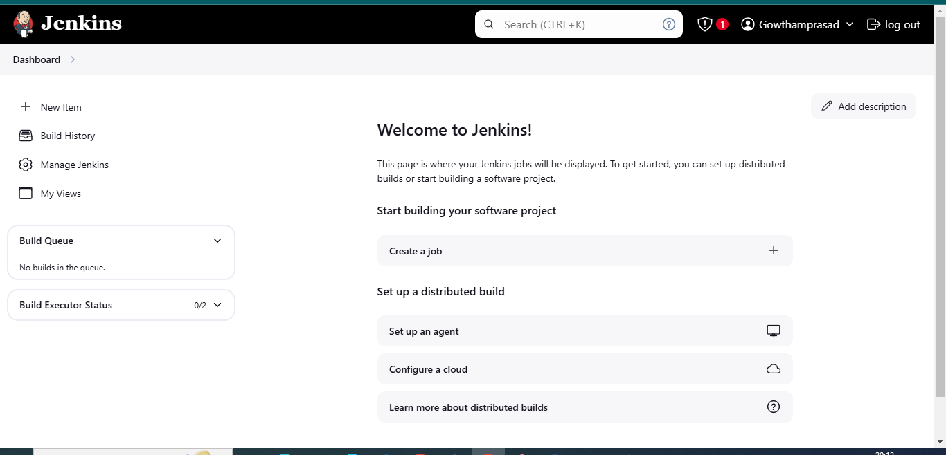
After click on save and continue Jenkins dashboard page will open

Slide 26


